Slide 1
Data Integration, Data Warehousing and Data Pre-processing
Mu Niu
Yue Zhao

Slide 2
Basic definitions
Knowledge discovery in databases
Data mining

Slide 3
Data Preprocessing
How to replacing missing values?
Take a guess
Replace by mean
Replace by unknown
How to transforming a attribute?
We try to transforming the country attribute by geographical location

Slide 4
Discretizing AC-S-ED with three different methods.
Discretizing into four equal-width intervals
Discretizing into four equal-frequency intervals
Discretizing based on mean and sigma.

Slide 5

Supervised discretization
We can do supervised discretization by Weka and get result directly.
Key point for supervised discretization is “entropy”. By finding cutting points for intervals, we get the best entropy, which means provide us the best purity of an interval.
Formula for calculating entropy

Slide 6
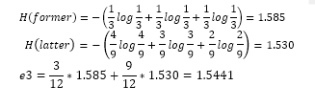
Feature Selection
Attributes selected by CFS
It is a forward research with no attributes in initial subset.
General steps of CFS process.

Slide 7
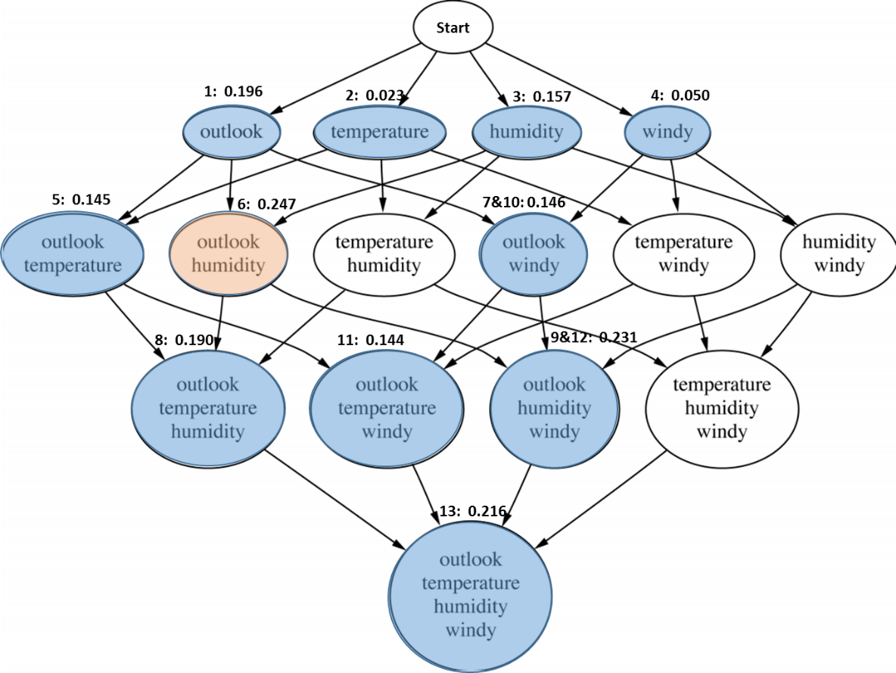

Slide 8


CFS formulas:
We calculate by hand base on formulas above, get the same result with Weka.

Slide 9
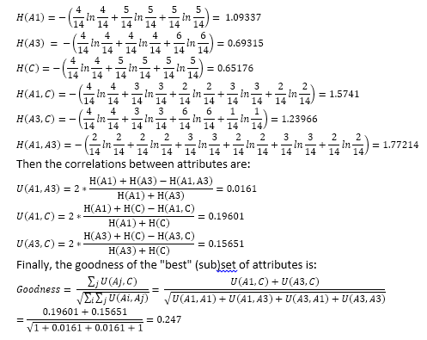

Slide 10
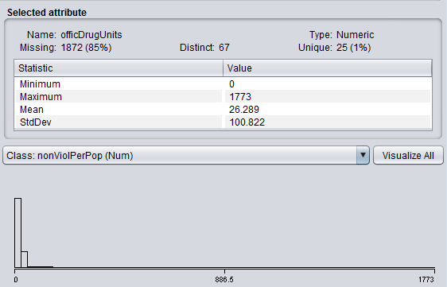
Exploring Real Data
Evaluate original dataset
Good things:
1, the dataset have enough samples
2, The attributes are explained well
Bad things:
1, Massive missing values
2, There are some redundant attributes and some confused value.

Slide 11
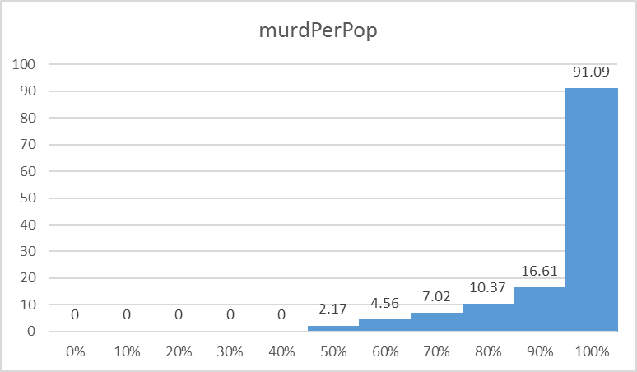
Percentiles attribute and list histogram

Slide 12
Get covariance matrix and correlation matrix by Excel.
We also moved attributes 13(medlncom) and 15(pctWdiv) because these two attributes have high correlation with others thus can be replaced.

Slide 13

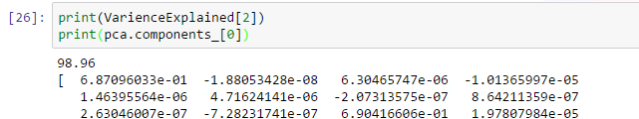
Dimensionality Reduction
We did dimensionality by both Weka and Python based on PCA, and get exactly the same results.

Slide 14
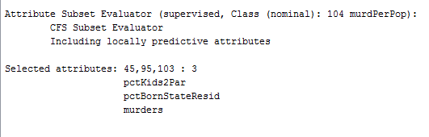
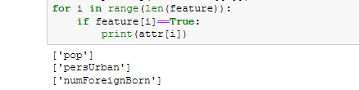
Feature Selection
We did feature selection based on CFS by Weka and python.

Slide 15
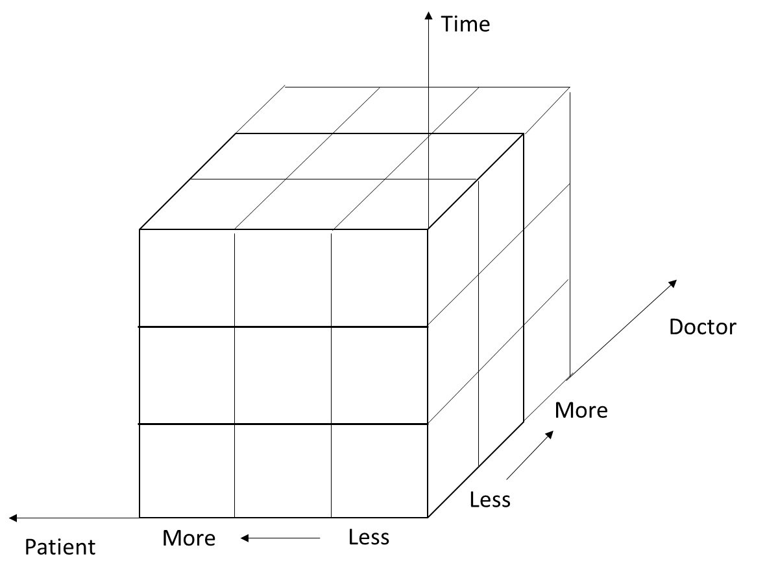
Data Integration, Data Warehousing and OLAP
Differences between the mediation approach and the data warehousing approach:
Mediation approach: keep the latest data
data warehousing approach: keeps all data that comes to it
Data warehouse
Depiction of this data warehouse:

Slide 16
Explain OLAP:
Roll up from day to month to year
Slice for year = “2014”
Roll up on patient from individual patient to all
Slice for patient = “all”
Get the list of total fee collected by each doctor in 2014

Slide 17
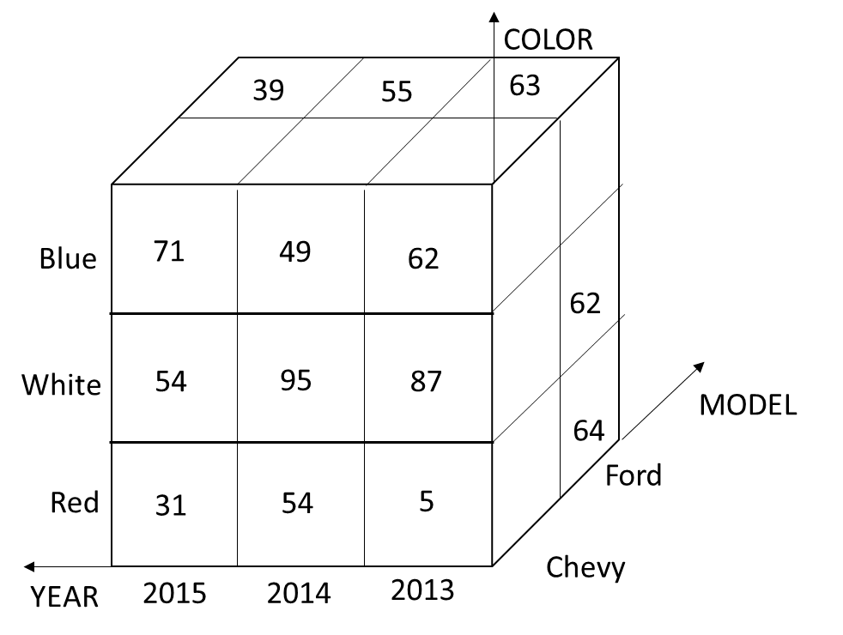
Data warehouse consisting of the three dimensions
Depict the data as a multidimensional cuboid.

Slide 18
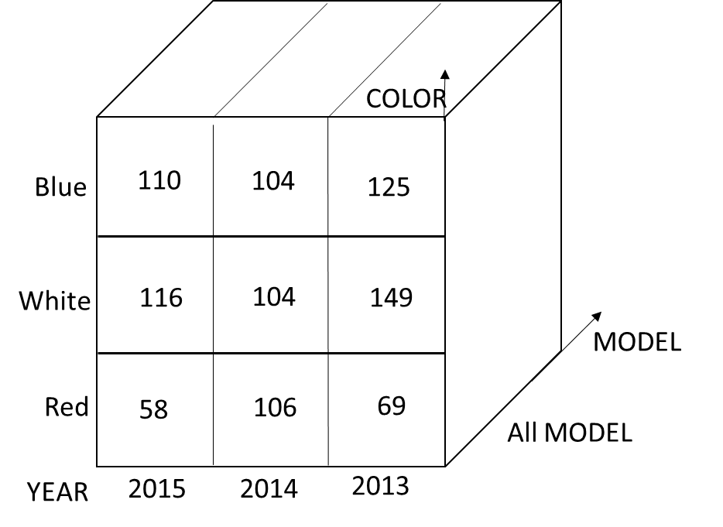
Depict the result of rolling-up MODEL from individual models to all.

Slide 19
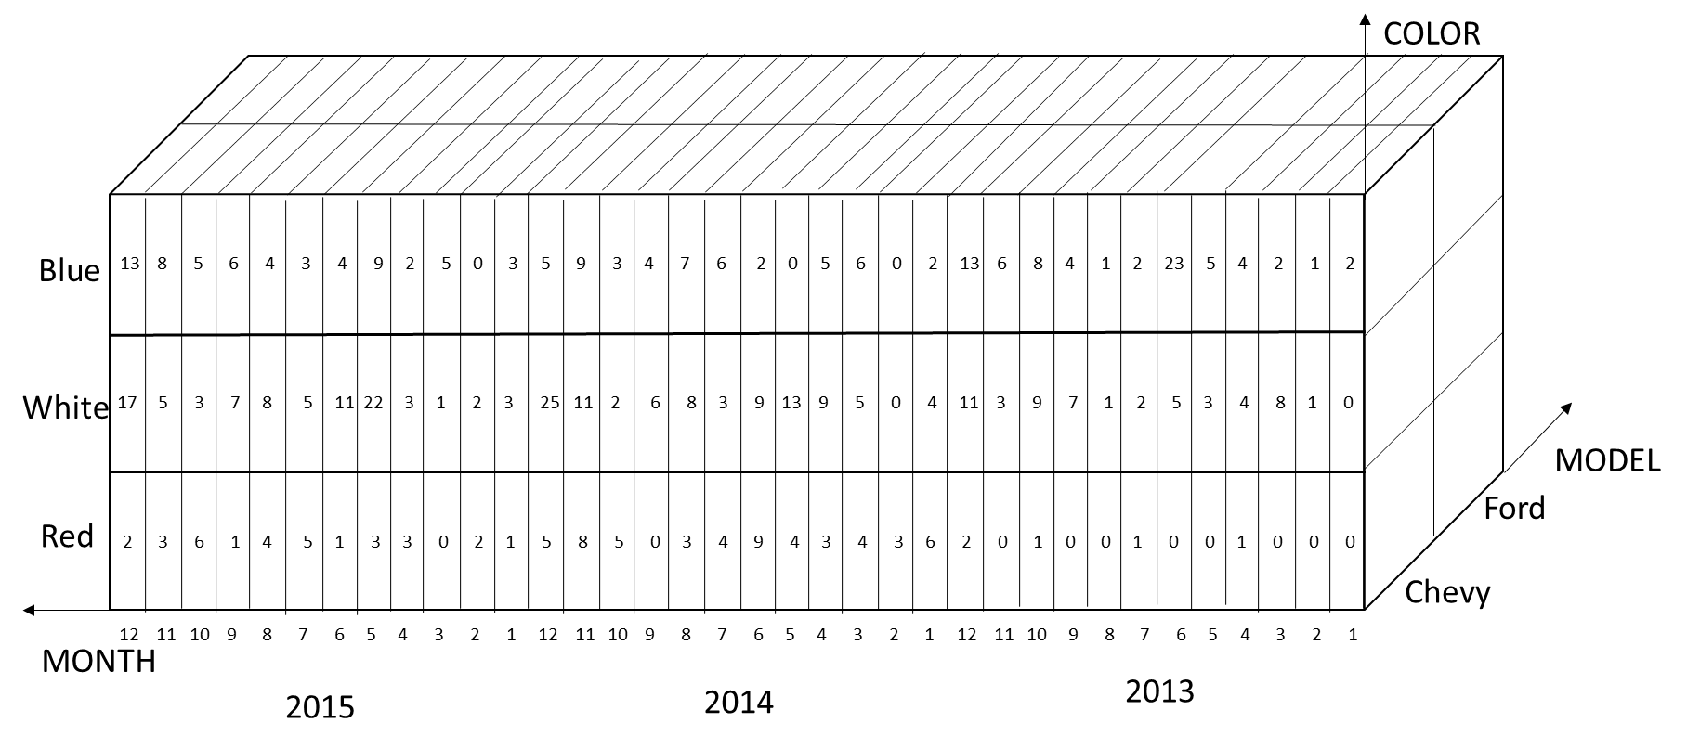
Depict the result of drilling-down time from YEAR to month

Slide 20
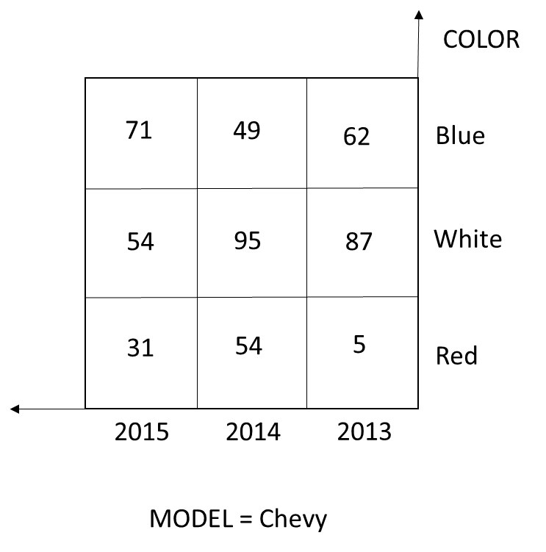
Depict the result of slicing for MODEL=Chevy

Slide 21
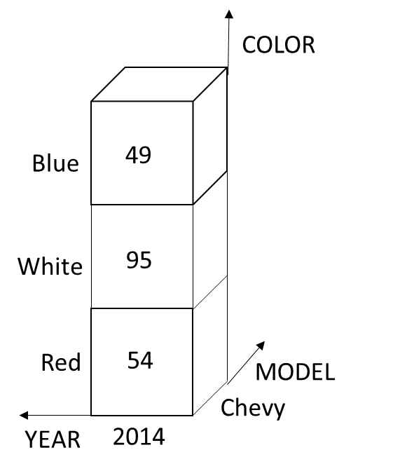
Depict the result of dicing for MODEL=Chevy and YEAR=2014.

Slide 22
what specific OLAP operations should one perform in order to obtain the total number of red cars sold?
1. Roll up from “Year” to “All Years”
2. Slice for Color = “Red”
3. Roll up from “Model” to “All Model”
4. Get the total number of red cars sold

